Slide 1
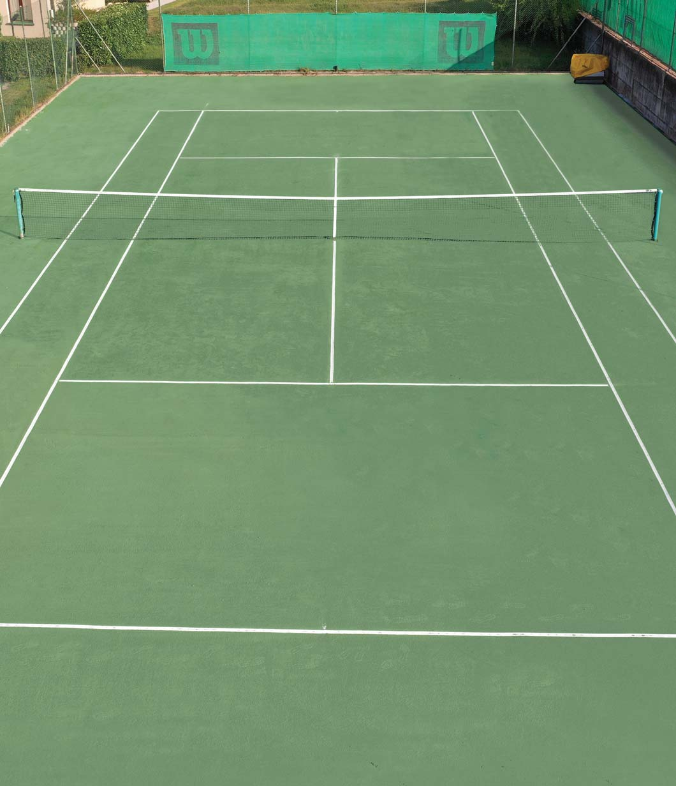
Predicting ATP Singles Match Outcomes with Supervised Learning:
Beating Elo but Not the Market
Antonio Cannito
University of Bari Aldo Moro
Machine Learning Course

Slide 2
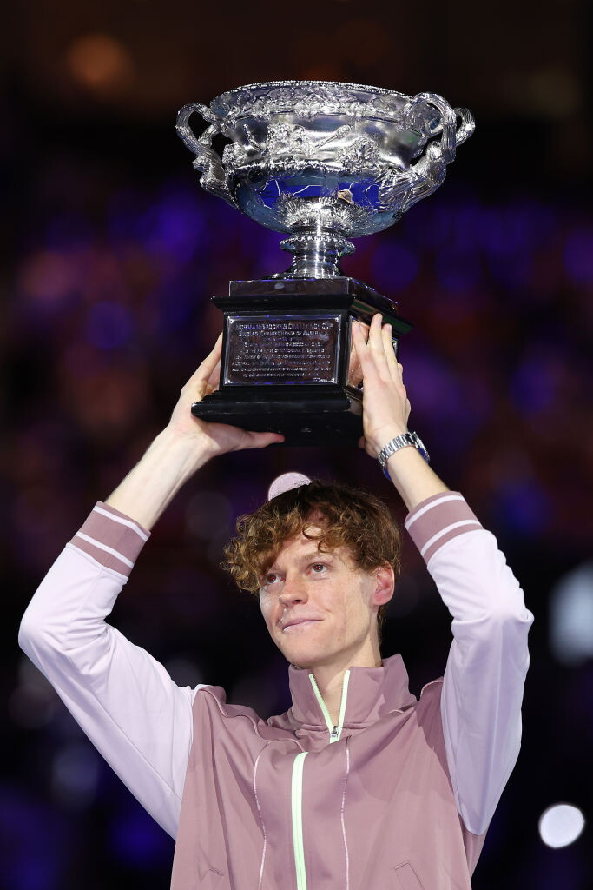
A prediction problem with an external referee
Predicting the winner of an ATP singles match is a binary classification task with an unambiguous outcome and public covariates.
An Unusual Benchmark
Bookmakers publish their own probabilities.
Falsifiable by Design
The model is measured against an external competitor, not only against itself.
Value = Information
A model is useful not because it reaches conventional accuracy, but because it carries information the market does not already have.
Notes:
Tennis is an unusually well-posed prediction problem. Binary outcome, no draws, public covariates.
What makes it different from most benchmarks is the external referee: bookmakers publish their own probabilities, with money at stake. So I don't only compare models against each other — I compare them against a competitor who is financially punished for being wrong.
That changes the definition of a good model. Not one that reaches some accuracy figure, but one that carries information the market does not already have.

Slide 3
Related work
Understanding the landscape of sports predictive modeling is crucial for contextualizing novel approaches.
This work intersects with, yet diverges from, established methodologies across three primary families.
Point-based hierarchical models estimate serve and return probabilities, propagating them through the scoring system. While highly interpretable, they necessitate granular point-level data and typically assume independence between points.
Rating systems summarise a player's performance into a single numerical value, updated after each match.
The Elo rating system remains a robust single-number predictor, with subsequent refinements often weighting updates based on tournament importance or playing surface to enhance accuracy and relevance.
Machine-learning approaches construct comprehensive feature vectors from extensive match histories, then apply general-purpose classifiers to predict outcomes. These methods leverage complex patterns and relationships within data, often achieving high predictive power but sometimes at the cost of interpretability.
This work does not aim to propose a superior rating system or a novel model architecture. Instead, its core contribution lies in quantifying the disparity between the predictions of a well-constructed supervised model and the actual market outcomes, offering insights into market efficiency and model performance.
Notes:
Three families. Point-based models propagate serve and return probabilities through the scoring system — interpretable but they need point-level data. Rating systems compress a player into one number; Elo is still the strongest single-number predictor. Machine-learning approaches build feature vectors and apply general classifiers.
My contribution is not a new rating or a new architecture. It is a measurement: how far a well-built supervised model sits from the market, and which choices actually move that distance.

Slide 4
From two winner-oriented sources to one symmetric dataset
Raw sources
Processed dataset
Match results — 75,010 rows — 51 columns
65,281 usable matches — 38 features
winner_name loser_name winner_rank loser_rank
w_ace l_ace surface score …
player_a player_b d_elo_blend d_log_rank
d_winrate_25 surface y
Roles assigned at random, attributes only as differences. Class balance 0.4971.
Bookmaker odds — 66,702 rows — 55 columns
Winner Loser B365W B365L PSW PSL Date …
No shared identifier. Every column is labelled by the outcome.
Excluded in sequence: 7,081 Davis Cup ties, 2,436 retirements and walkovers, 212 without a ranking.
Notes:
Two sources that don't talk to each other. Match results from the TML-Database, 75,010 matches. Odds from tennis-data, 66,702.
Both are winner-oriented: every column is labelled by the outcome. That is the problem I'll come back to in two slides.
After cleaning, 65,281 usable matches. I exclude Davis Cup — team competition, different incentives — retirements and walkovers, and matches without a ranking. Retirements stay in the history that builds features, because a match played halfway still counts as load; they just aren't prediction targets.

Slide 5
Joining the two sources
No shared identifier and names written differently, so the join key is the player pair plus a 6-day window on the date
Compound surnames are frequent on tour and blur the forename/surname boundary, so every plausible segmentation of a full name is generated, and the join is accepted if any of them matches
Coverage with the market: 60,082 of 65,281 matches, 92.0%
Notes:
The two sources share no identifier and write names differently: "Juan Martin del Potro" in one, "Del Potro J.M." in the other.
So the join key is the pair of players plus a six-day window on the date. The window is needed because one source records the tournament start date and the other the match date, and a tournament runs a week.
The join succeeds for 92% of matches. That is linkage success, not odds availability

Slide 6
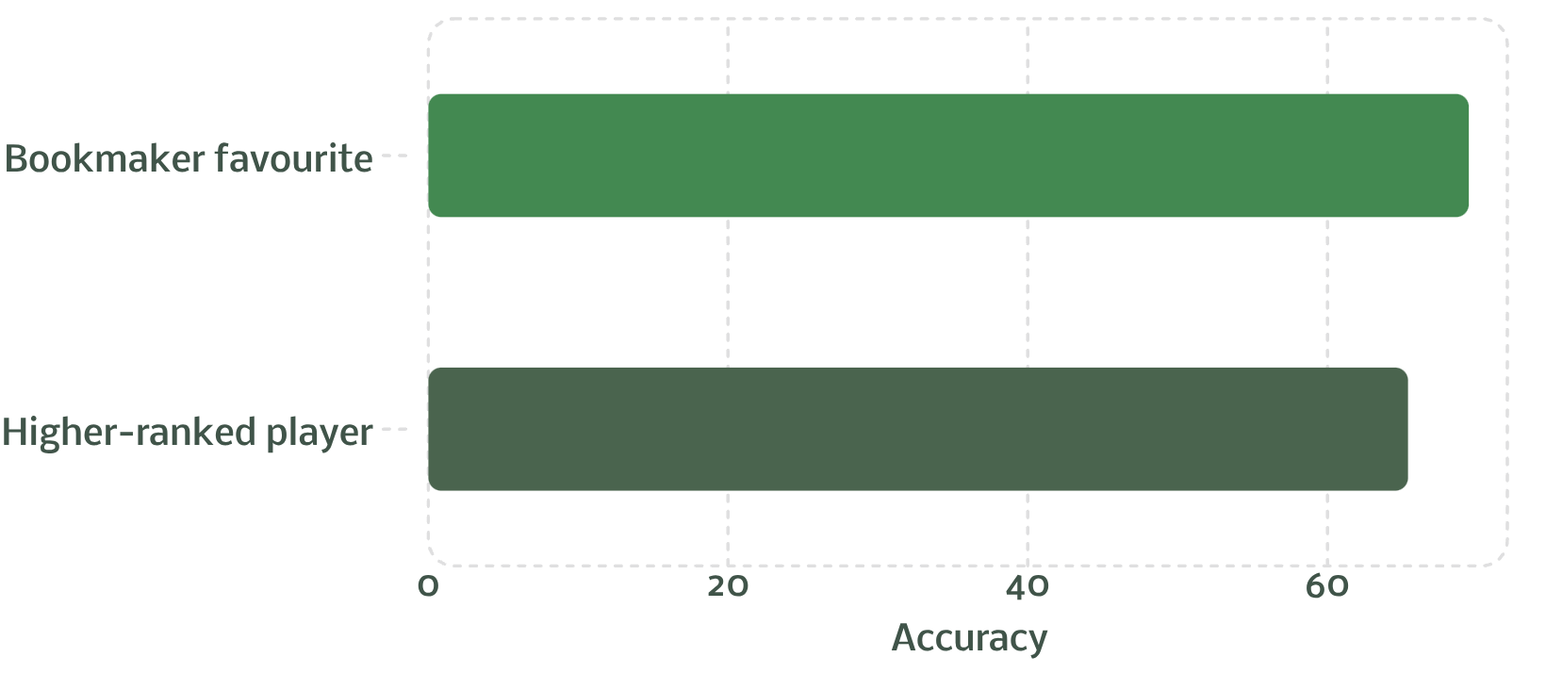
Two baselines
The higher-ranked player wins 65.37% of matches: no model, no history
The bookmaker favourite wins 69.43%
Between them lies the room in which machine learning can operate; measuring how much is recoverable is the question of this work.

Slide 7

Two failure modes that produce no error message
Label ordering
Temporal leakage
The winner is always the first column in the raw data
A feature left oriented as "winner minus loser" predicts the label almost perfectly
Ruled out by: random A/B slots, features only as differences
Every player attribute is itself computed from past matches
Computed in one pass over the whole dataset, a 2010 match carries 2015 results
Ruled out by a single chronological pass, history read before it is updated
Neither raises an exception. Both simply make the numbers better.
Notes:
Two ways to get excellent numbers that mean nothing, and neither raises an exception.
Label ordering: the winner is always the first column. A feature computed as "winner minus loser" encodes the answer outright. You'd see 95% accuracy and conclude you had solved tennis.
Temporal leakage: almost every player attribute is derived from past matches. Computed in one careless pass over the whole dataset, a 2010 match would carry 2015 results

Slide 8
Symmetric representation
Eliminating ordering bias in player matchup models through randomized slot assignment and difference-based features.
The Flip Test
Slot A | Slot B | p(A wins)
Player A | Player B | 0.63
Player B | Player A | 0.34
The Trap
In raw data, the winner is always listed first. Any feature built as winner − loser encodes the label outright, leaking the target into the input.
Same match, swapped order.
These should sum to 1. They sum to 0.97.
The Fix
Players are assigned to slots A and B at random (fixed seed); y = 1 if A wins.
Class balance: 0.4971.
Attributes enter only as differences d = x_A − x_B, which flip sign when slots are swapped.
After symmetrisation
The Residue
Not everything flips. The differences do, but the surface, the round,
and the model's own baseline are the same in either ordering.
That is what breaks the symmetry.
Slot A | Slot B | p(A wins)
Player A | Player B | 0.645
Player B | Player A | 0.355
The Solution
Predict each match in both orderings and average:
p_sym = ½ [ p(A, B) + 1 − p(B, A) ]
The two predictions cancel term by term. The residue becomes exactly
zero
Notes:
The fix for label ordering. Players go into slots A and B at random with a fixed seed; y equals 1 if A wins. Class balance 0.4971, as expected.
Attributes enter only as differences, which flip sign when the slots swap.
Now the flip test. If I predict the same match in both orderings, the two probabilities should sum to one. They sum to 0.97. Not everything flips: the surface, the round and the model's own baseline are identical in either ordering, and that residue breaks the symmetry.
The remedy is to predict both orderings and average. Then the terms cancel and the residue becomes exactly zero.

Slide 9
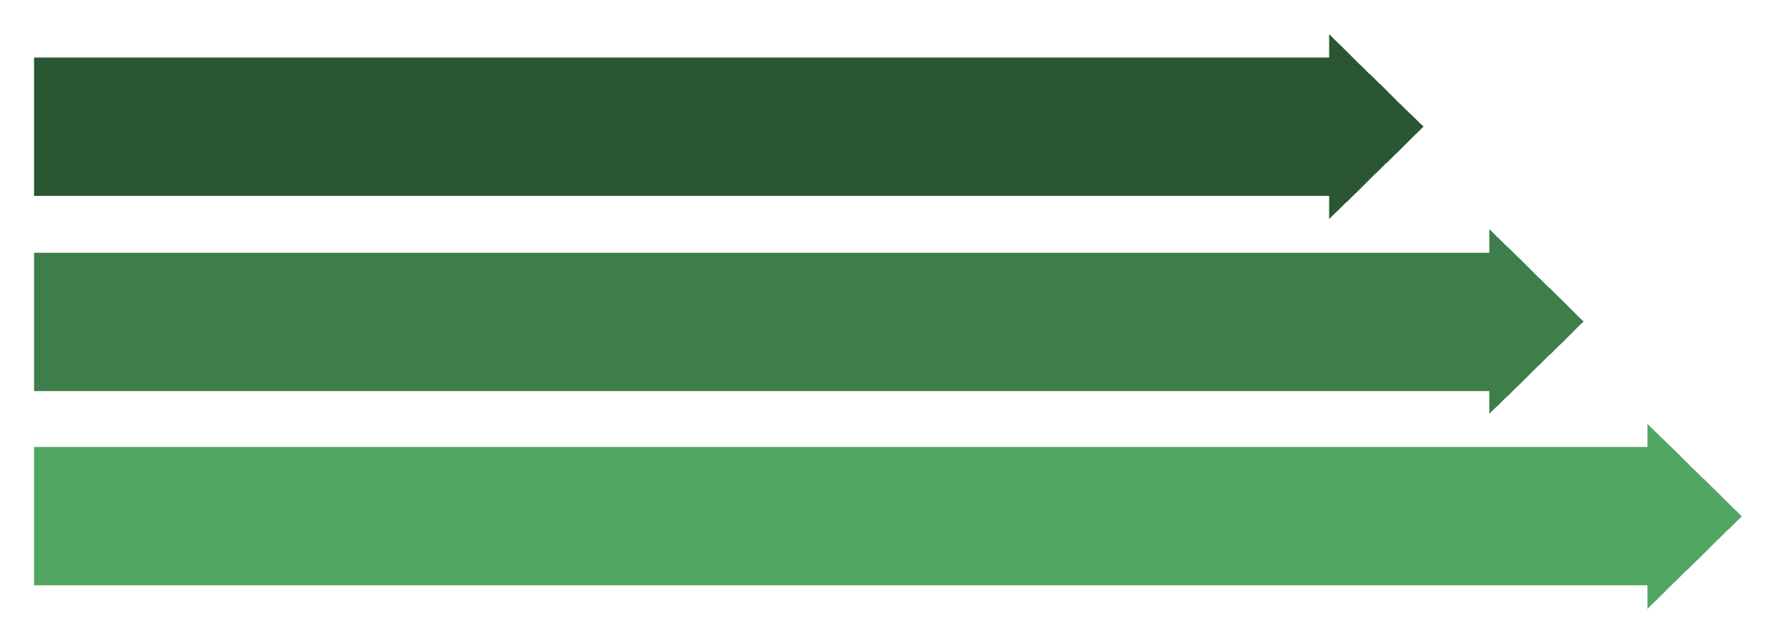
Causal features
Date alone is not enough
The recorded date is the tournament START date, identical for every match of an event. Sorting by date alone could place a final before a first round.
Full ordering:
READ history
BUILD feature vector
UPDATE history
Tournament date
Tournament_id
Round
Match number
One pass. The outcome is written only after the features are frozen.

Slide 10
38 Features
Nine blocks, built in one chronological pass.
Block | What it contains
Elo ratings | Global, per surface, and the blend of the two
Rank and points | Log-transformed: the rank–outcome relation saturates beyond about 100 places
Recent form | Win rate over the last 10, 25 and 50 matches, the same restricted to the current surface, and career experience
Load and rest | Matches in the last 30 and 90 days, days since the last match
Injury proxies | Retirement rates, not counts, over 180 and 730 days
Technical stats | Serve and return performance, averaged over the previous 20 matches
Head-to-head | Balance of past meetings plus how many meetings exist
Demographics | Age, height, handedness
Context | Surface, tourney level, round, format, indoor, draw size
30 of the 38 are differences d = xA − xB and flip sign when the slots are swapped. The remaining 8 are shared by both players and do not.

Slide 11

Elo ratings
$$E_{A}=\frac{1}{1+{10}^{\left(R_{B}−R_{A}\right)/400}}$$
Expected score for A. Ratings move by K × (actual(1=win, 0=lose) − E_{A}expected).
Two design choices
Two parallel systems. One global rating, one per surface, combined linearly with weight λ. A grid search on the training period alone selected λ = 0.5.
A K-factor that decays. K = k₀ / (n + offset)^shape, where n is matches played. Newcomers move fast, veterans stay stable.
Elo alone as a baseline: 68.92% accuracy | 0.5864 log-loss

Slide 12
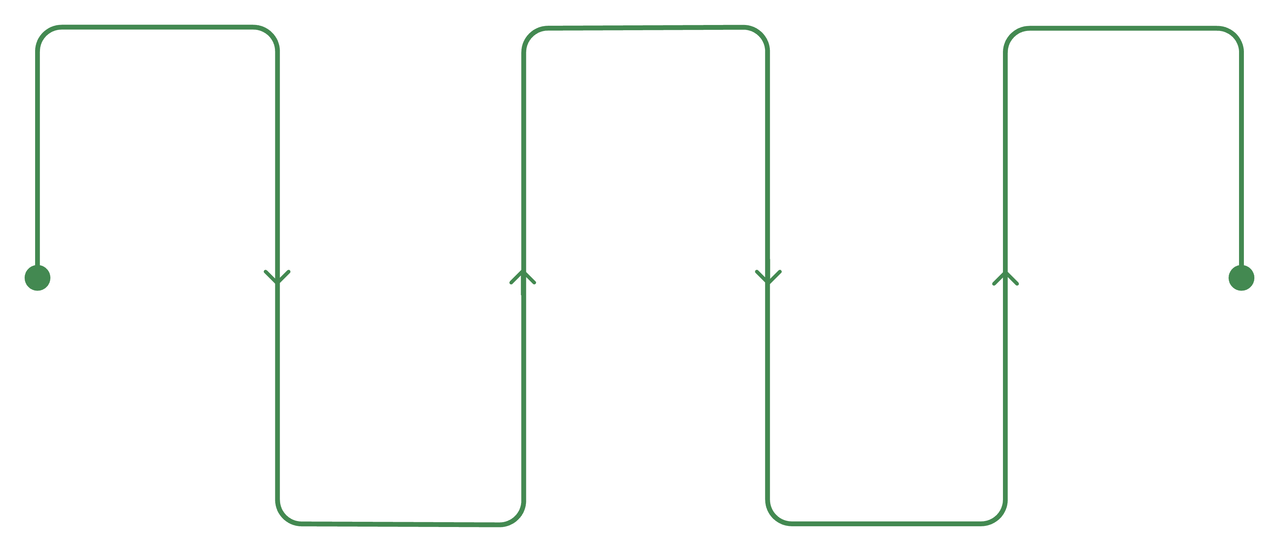
Rolling-origin cross-validation
Burn-in
Rolling folds
Holdouts
2000–2002 — feeds Elo, never evaluated
Fold 2: train 2003–2011 Q1 → test Q2 2011
2019–2024 : quality comparison
2023–2024 : betting test
Rolling folds
Rolling folds
Fold 1: train 2003–2010 → test Q1 2011
… up to Fold 32: train 2003–2018 Q3 → test Q4 2018
The training window expands; the test quarter always lies in the future. 32 folds.
Why not k-fold
Why expanding, not sliding
Why quarterly
Shuffling matches would let the model train on 2018 to predict 2011. Tennis has a direction; the validation must respect it.
Elo and form features are cumulative. Discarding old matches would throw away the history the features are built from.
A quarter is long enough to contain several tournaments and short enough to give 32 folds from eight years.

Slide 13
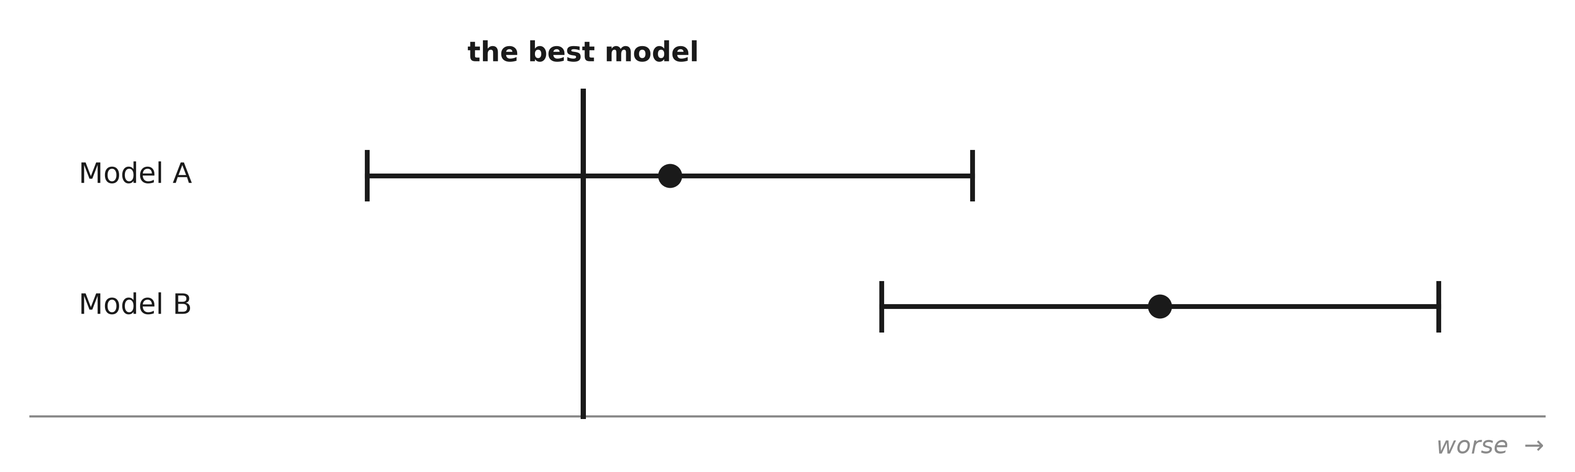
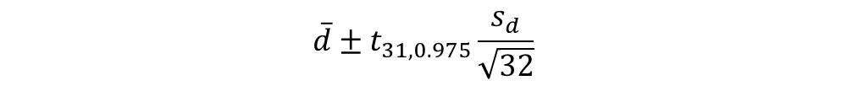
Model comparison
Each model is compared with the best one, fold by fold. The 32 differences in log-loss give one confidence interval.
0
Model A: the interval contains zero
Model B: the interval excludes zero
In some folds A was ahead, in others behind. We cannot say which model is better. But we can say the difference is no larger than the far end of the bar and that bound is the result.
B was worse in almost every fold. The difference is real, and it is at least the near end of the bar.
$$\overline{d}±t_{31,0.975}\frac{s_{d}}{\sqrt{32}}$$
· Dot = mean of the 32 differences. · Bar = 95% confidence interval
· Caveat: folds share training data, so the bars are slightly narrow.
Notes:
Each model is compared with the best one fold by fold. Thirty-two paired differences in log-loss give one confidence interval.
If the interval contains zero, I cannot say which model is better — but I can say the difference is no larger than the far end of the bar, and that bound is the result. If it excludes zero, the difference is real and at least the near end.
I report intervals rather than p-values because the question is how large the differences are, not whether they are exactly zero.
The formula is a standard Student confidence interval, applied to the 32 paired differences.
d-bar is their mean — that's the dot on the chart. s-d is their standard deviation. Dividing by the square root of 32 turns it into the standard error of the mean: how precisely I know that average.
The t multiplier is 2.04. It's Student's t rather than the normal 1.96 because I estimate the standard deviation from the same 32 numbers instead of knowing it in advance, and with a small sample that uncertainty has to be paid for. The 31 is 32 minus one degree of freedom, and 0.975 puts two and a half percent in each tail for a two-sided 95% interval.
The formula divides by the square root of 32, which assumes the 32 differences are 32 independent observations. They aren't: the training windows expand a quarter at a time, so consecutive folds share 97 to 99 percent of their data. The intervals are therefore slightly narrower than they should be.

Slide 14

Eleven classifiers
Seven Families
Linear
Probabilistic
Instance-based
Logistic L1
Logistic L2
Gaussian naive Bayes
k-NN (k=100)
Trees
Ensembles
Kernel
Decision tree
Random forest
Gradient boosting
AdaBoost
Linear SVM
RBF SVM
Neural
Feed-forward NN (64, 32)
Nothing was tuned. Every model runs on its standard scikit-learn configuration, fixed once and never searched over.
Tuning each to a different degree would confound algorithm quality with search effort the model that got the most attention would win, and the comparison would measure the author, not the algorithms.

Slide 15
Betting test
Accuracy measures predictions. The market measures whether they are worth anything: the price already contains information the model cannot see.
EV = p · o − 1
1/oA + 1/oB = 1.0262
Bet when EV > τ
Expected profit per unit staked. p is the model's probability, o the decimal odds. We bet one side per match whichever has the higher expected value and only if it clears the threshold τ.
Bookmaker's margin: 2.62%
Implied probabilities should sum to 1. They sum to 1.0262. The extra 2.62% is the bookmaker's margin on the test years, the bar the model must clear before any edge exists.
How the simulation is run
Why we use the raw odds
One unit per bet
We could divide the margin out and recover what the bookmaker really believes. We do not, because the odds actually paid are the raw ones. Removing the margin would lower the bar, place more bets, and show returns nobody could collect.
So, matching the bookmaker is not enough.
The model has to beat him by more than 2.62%.
No stake sizing, so the return reflects what the model knows rather than how the bankroll was managed.
Seven thresholds, τ from 0 to 0.30
A high τ bets only where model and market disagree strongly.
Notes:
Accuracy measures predictions. The market measures whether they are worth anything.
Expected value is p times the decimal odds, minus one. I bet one side per match — whichever has the higher expected value — and only if it clears a threshold tau.
The bar is the bookmaker's margin. Implied probabilities should sum to one; they sum to 1.0262 on the test years. That extra 2.62% is the margin, and matching the bookmaker is not enough — the model has to beat him by more than that.
I deliberately do not divide the margin out here, because the odds actually paid are the raw ones. Removing it would lower the bar, place more bets, and show returns nobody could collect.

Slide 16
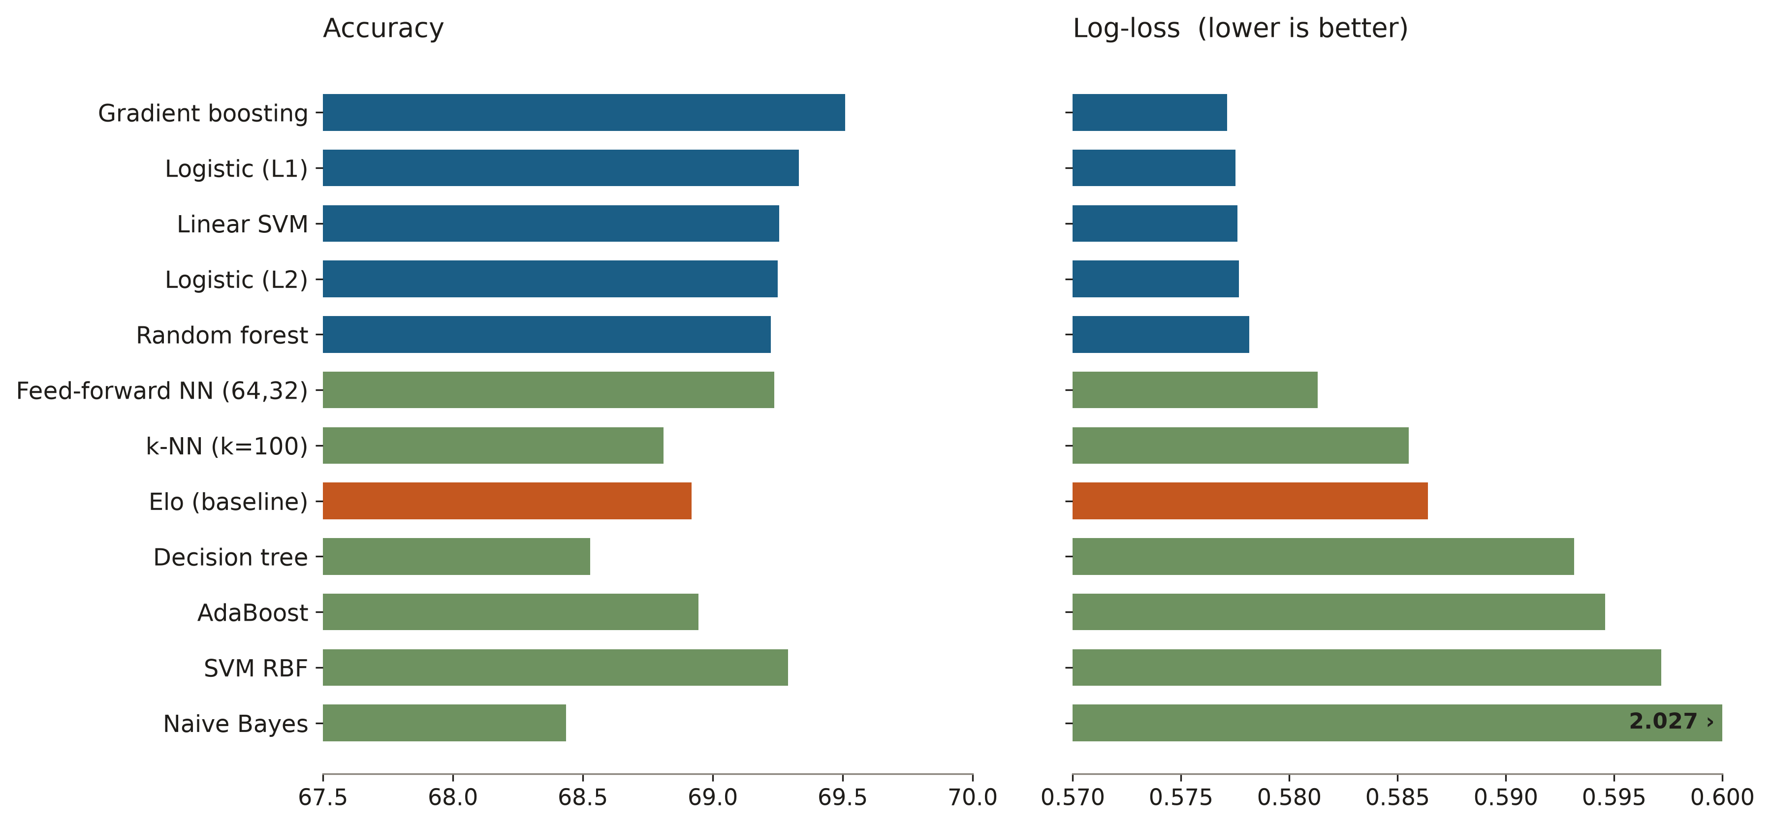
Classifiers results
Eleven classifiers, 32 quarterly folds
For every model above the rule the 95% interval on the paired difference from the best contains zero and is bounded above by 0.0021.
Elo is 0.0093 away, more than four times the most that separates them from each other (0.0021).
The same analysis on accuracy agrees: seven models tied within 0.3 points, Elo beaten by 0.59.
Everything that follows uses gradient boosting, first in the ranking.

Slide 17
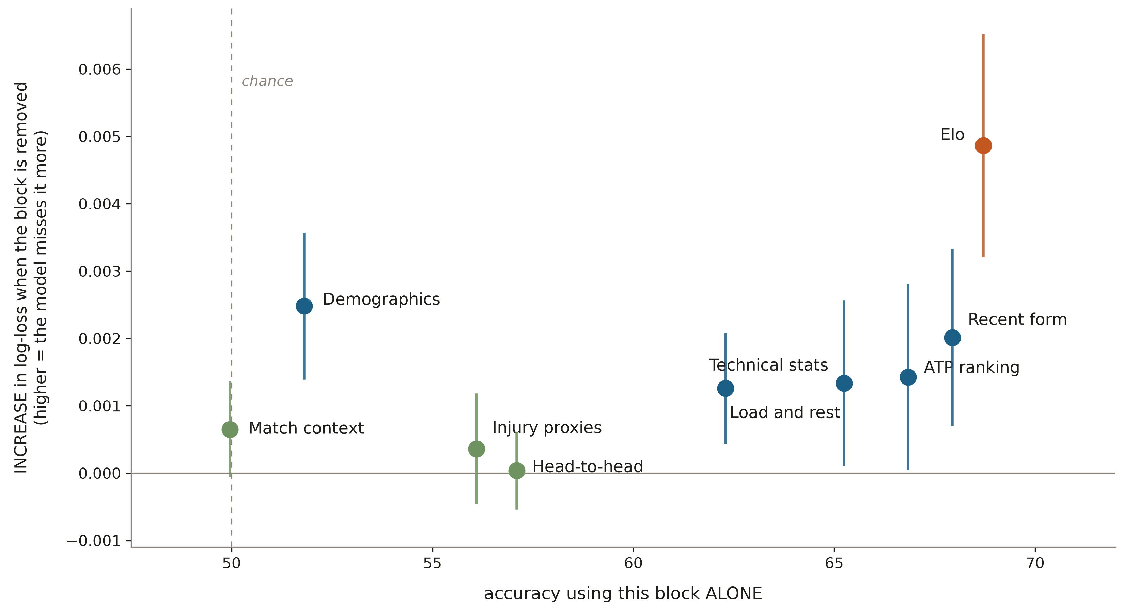
Prediction
Nine feature blocks. Horizontal: accuracy using that block alone. Vertical: increase in log-loss when it is removed from the full model.
Demographics predicts nothing, matters anyway
Head-to-head contributes nothing
Match context
51.8% alone, barely above chance. Yet removing age, height and handedness costs 0.0025. They do not predict; they modulate the other features.
57.1% alone, but its interval is [−0.0005, +0.0006]. Elo and recent form already carry the information. Of 35,368 distinct pairs, 62.9% have met exactly once.
49.96% alone. Surface, round and format cannot say WHO wins.
Any departure from 50% would have signalled a defect in the symmetric representation.

Slide 18
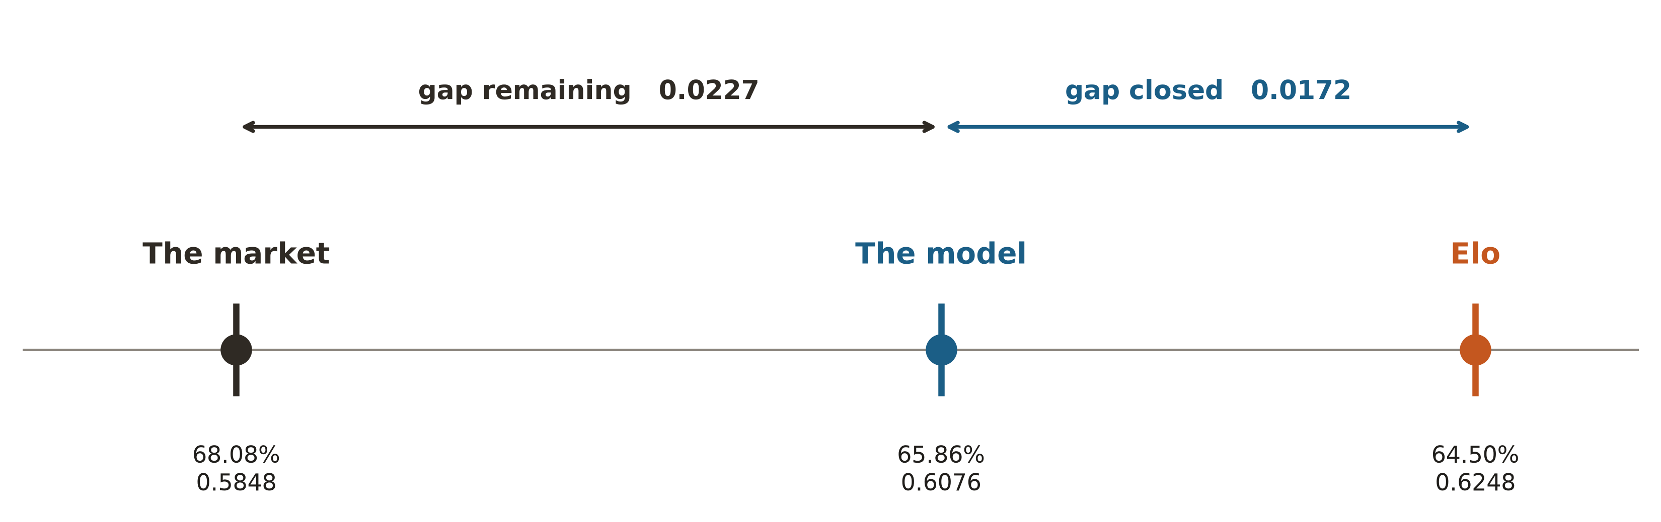
Beat Elo, lose to the market
Trained on 2003-2018. Evaluated on everything after it: 2019–2024, the 12,824 matches for which market odds exist.
"The market" is the bookmaker's odds converted to a probability, with the margin divided out so the two sides sum to one.
0.0172 closed
0.0227 remaining
1.4 accuracy points over Elo, and Elo was beaten in 29 of the 32 cross-validation folds.
This is what 38 features and a full model search bought.
Larger than what was closed.
The bookmaker is further ahead of the model than the model is ahead of Elo.
Less than half the distance. And the ceiling is not the algorithm, eleven of them agreed.
The margin is divided out here because comparing probabilities requires a valid distribution. It is not divided out in the betting simulation, where the price actually paid is what matters.

Slide 19
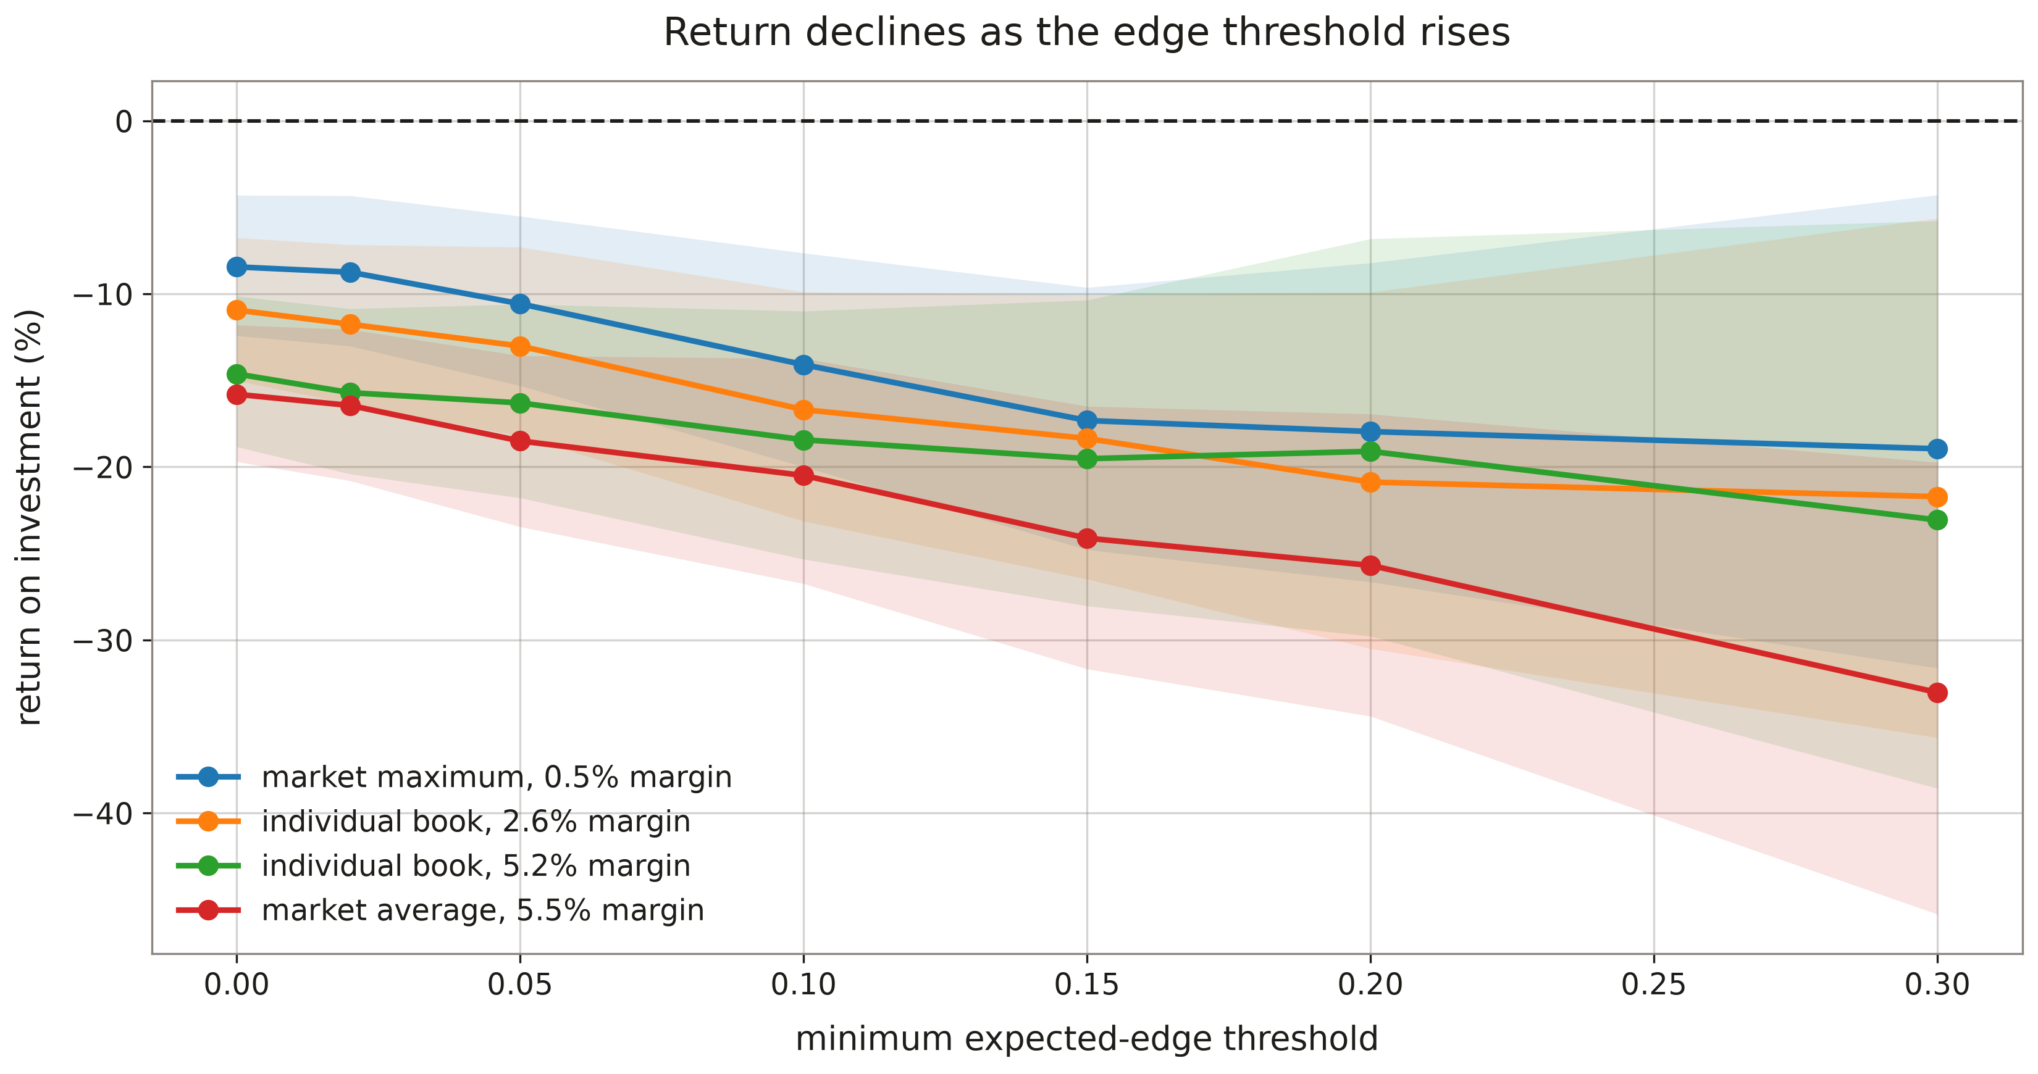
Betting test results
2023–2024. One unit per bet, four odds sources, seven thresholds.
Every return is negative.
The margin is not the cause.
It gets worse, not better.
At the best price available anywhere the
margin is 0.5%, and the loss is still 8.45%.
All four sources, all seven thresholds, and every bootstrap interval stays below zero. Not bad luck.
A higher threshold bets only where model and market disagree most. Real information would improve the return there. It falls instead.
The model bets mostly on underdogs and overvalues them.

Slide 20
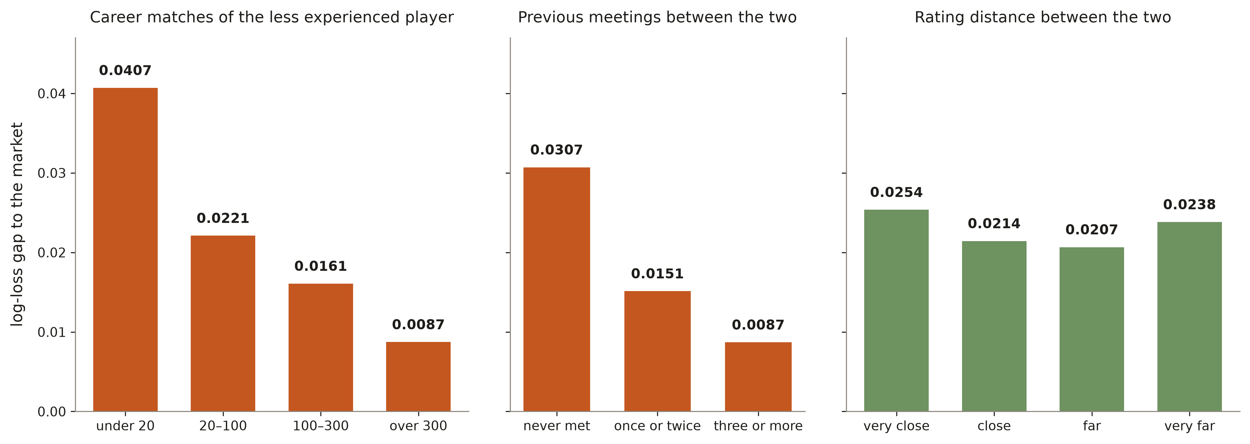
The gap
The market wins in all 29 segments examined. The interesting part is by how much.
History predicts the gap
Difficulty does not
0.0087 when both players have long careers and have met before. 0.0407 when one of them has fewer than 20 career matches, almost five times larger.
Split the same matches by how evenly the two are rated and the gap barely moves: 0.0207 to 0.0254.
Close matches are harder for everyone, including the bookmaker.
This is an information deficit, not a modelling one.

Slide 21

Conclusion
The algorithm does not matter
The representation does
The ceiling is the data
A symmetric, verifiably causal feature pipeline puts all five clearly above a tuned surface-blended Elo. Three negative results came with it: head-to-head adds nothing, injury proxies add nothing, and the market cannot be beaten.
All five sit clearly below the betting market. The gap is 0.0087 where match history is dense and 0.0407 where it is thin and flat across difficulty.
Five classifiers of very different inductive bias converge to the same performance. Whatever separates them is at most 0.0021 of log-loss, under a quarter of what separates them from Elo.
The binding constraint is the information in result data.
The remedy lies in different sources: current physical condition, and information on players with thin history.

Slide 22
Limitations
The betting simulation is not a strategy. | Closing odds, not always obtainable at decision time. No stake limits, no commissions. The returns measure informational content relative to the market, and nothing more.
Nothing was tuned. | Deliberate, to keep the comparison between families fair. A tuned model would likely gain a little, though five model classes converging suggests very little.
The folds are not independent. | The training windows expand, so consecutive folds share almost all their data. The confidence intervals are therefore slightly narrower than they should be.

Slide 23
THANKS FOR YOUR ATTENTION
Antonio Cannito · a.cannito21@studenti.uniba.it

